Slide 1


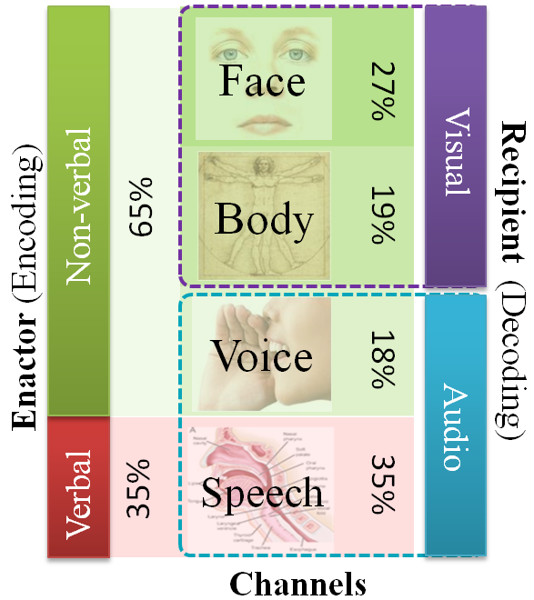
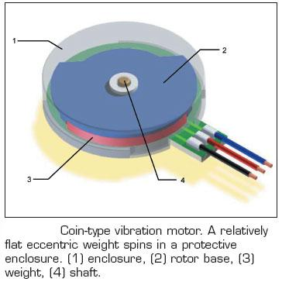
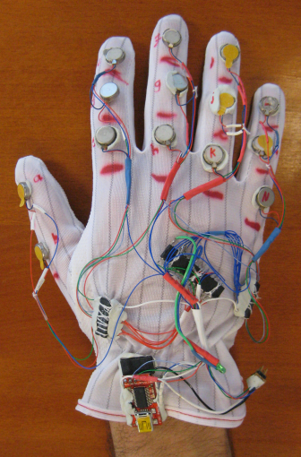
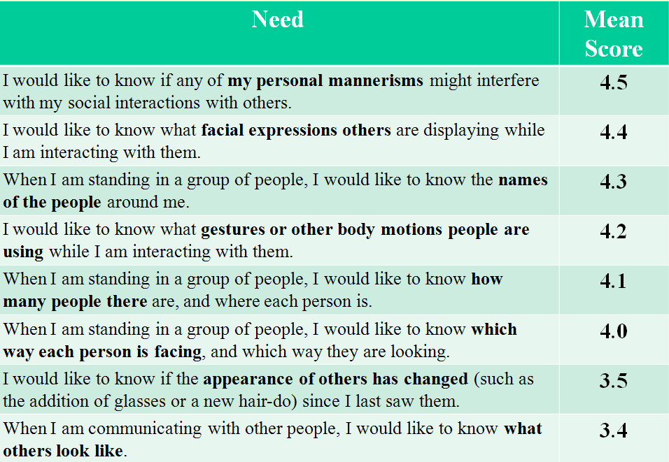
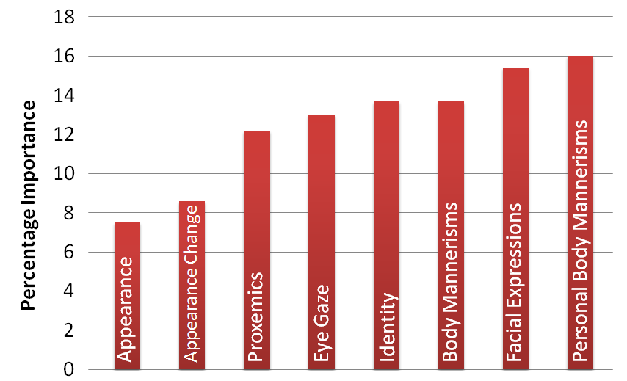
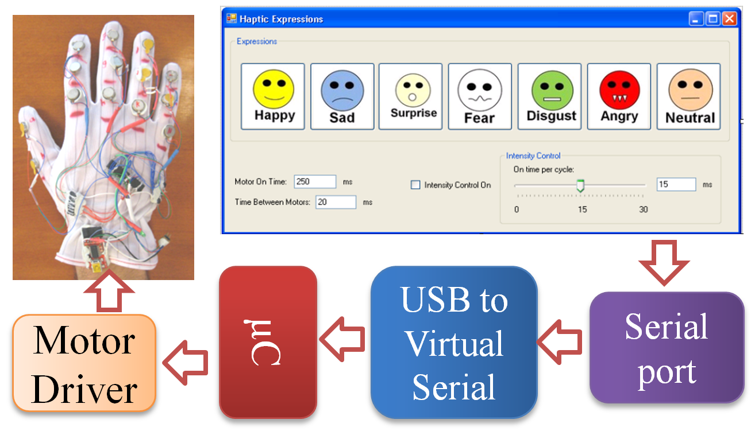
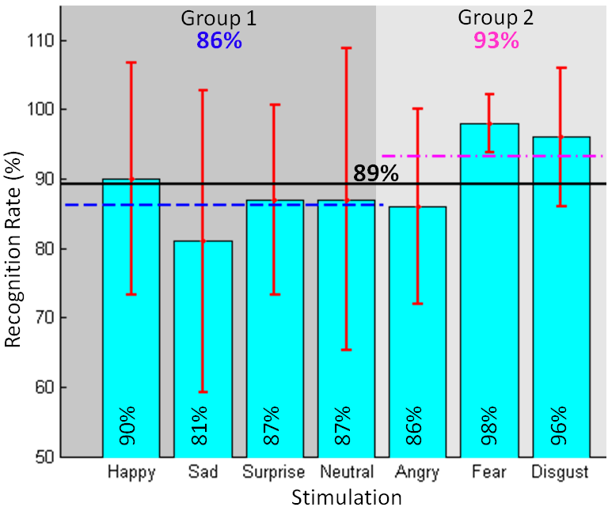
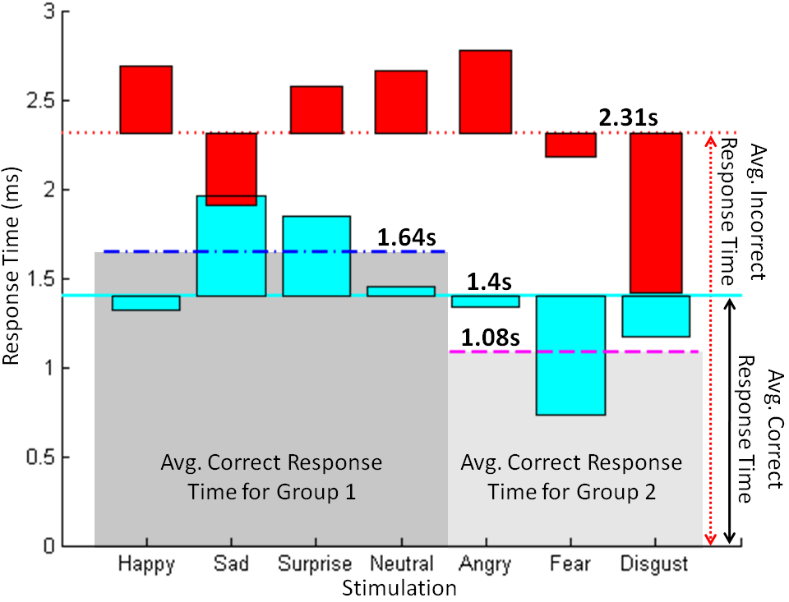
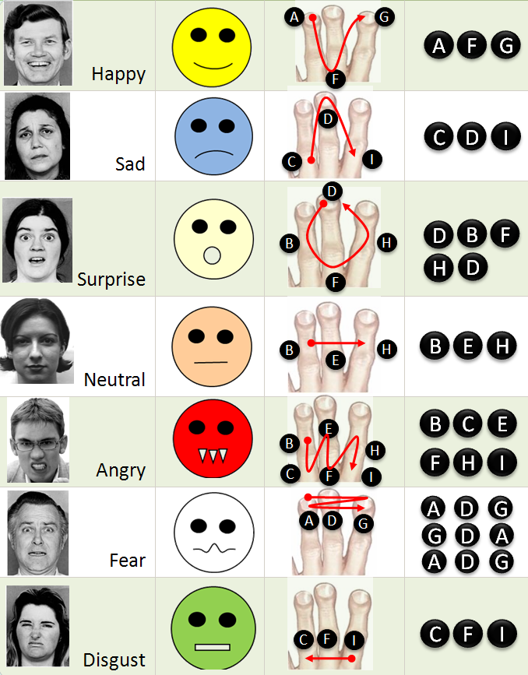
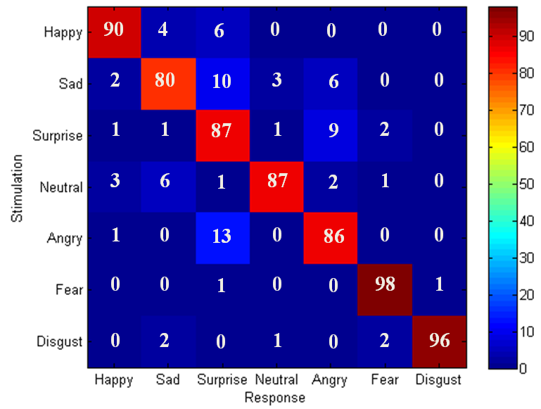
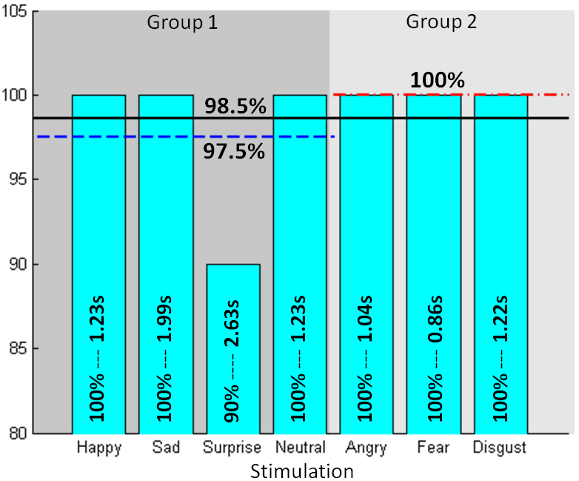
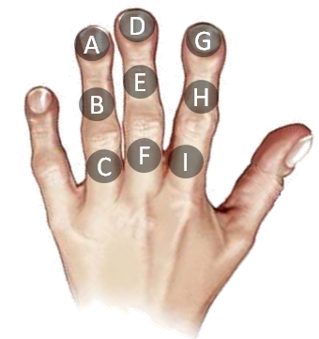
VibroGlove
An Assistive Technology Aid for Conveying Facial Expressions
Sreekar Krishna† , Shantanu Bala, Stephen McGuire, Troy McDaniel &Sethuraman Panchanathan
CUbiC Center for Cognitive Ubiquitous Computing
http://cubic.asu.edu
Motivation
Shaftless Vibration Motor
Social interactions are an essence of healthy living.
Major portion of social interactions happen through non-verbal cues, especially visual cues.
People with physical and cognitive disabilities are at a loss when it comes to social interactions.
Assistive and rehabilitative aids could prove beneficial towards enriching personal and professional lives of individuals with disabilities.
Atmel ATmega168 μC
Darlington Motor Driver
μC Programming Port
USB-Serial Interface
Debug Port LED
† Contact Author: Sreekar Krishna, Graduate Research Assistant, Center for Cognitive Ubiquitous Computing (CUbiC: http://cubic.asu.edu/), Arizona State University, Tempe, AZ. Ph: (480) 727-3612 Fax: (480) 965-1885 Email: Sreekar.Krishna@asu.edu

